Slide 1
ISO (International Organization for Standardization)
Unit-III

Slide 2
Contents
About ISO
Structure of ISO-9000,
ISO 9000 origin,
Elements of ISO-9001,
Benefits from ISO-9001 certification
Aspects of quality systems,
Certification methodology and cost involved,
ISO 14001 (Environmental Management)

Slide 3
What is IS0 ?
ISO is an independent, non-governmental international organization with a membership of 162 national standards bodies.
Through its members, it brings together experts to share knowledge and develop voluntary, consensus-based, market relevant International Standards that support innovation and provide solutions to global challenges.
They give world-class specifications for products, services and systems, to ensure quality, safety and efficiency.
ISO has published 21833 International Standards and related documents, covering almost every industry, from technology, to food safety, to agriculture and healthcare.

Slide 4
International Standards Organization
The ISO specifies requirements for a quality management system
Basic form of the Standard requires:
Understand product and service requirements
Establish processes to meet those requirements
Provide resources to run the processes
Operate, monitor, and measure the processes
Improve continuously, based on analysis of the results

Slide 5
Origin of ISO 9000
The story of ISO 9000 is a story of standards, methods and regulation. The brief history that follows is in no way comprehensive but is intended to illustrate things:
Standards are an ancient concept that survived several millennia; that a means of verifying compliance often follows the setting of standards;
Formalizing of working practices is centuries old and seen as a means to consistently meet standards;
Market regulation (relative to the standard of goods and services) has been around for centuries for the protection of both craftsmen and traders.

Slide 6
What is the purpose of ISO 9000?
The purpose of these standards is to assist organizations of all types to implement and operate effective quality management systems.
This provide a vehicle for consolidating and communicating concepts in the field of quality management that have been approved by an international committee of representatives from national standards bodies.

Slide 7
ISO is an independent, non-governmental international organization to give world-class specifications for products, services and systems, to ensure quality, safety and efficiency.
True/ False

Slide 8
ELEMENTS OF ISO 9000/9001
The standards of ISO 9000/9001 detail 20 requirements for an organization's quality management system in the following areas:
Management Responsibility
Quality System
Order Entry
Design Control
Document and Data Control
Purchasing
Control of Customer Supplied Products
Product Identification and Tractability
Process Control
Inspection and Testing Control of Inspection, Measuring, and Test Equipment
Inspection and Test Status
Control of Nonconforming Products
Corrective and Preventive Action
Handling, Storage, Packaging, and Delivery
Control of Quality Records
Internal Quality Audits
Training
Servicing
Statistical Techniques

Slide 9
ADVANTAGES OF ISO 9000
Increased marketability
Reduced operational expenses
Better management control
Increased customer satisfaction
Improved internal communication
Improved customer service
Reduction of product-liability risks
Attractiveness to investors

Slide 10
Benefits to Society
Businesses
Allows them to produce a product under worldwide standards
Customers
Provides a wider range of products
More competition between producers
Governments
Provide standards on health, safety and environmental legislation
Trade Officials
Helps create a more level playing field for all competitors

Slide 11
Benefits to Society
Developing Countries
Helps these countries invest their scarce resources more wisely in order to produce products that meet worldwide standards
Consumers
Provides assurance of quality, safety, and reliability
Everyone
Assures the things we use in everyday life are of the highest quality
Planet
Provides standards on air, water and soil quality

Slide 12
Purpose of ISO is to assist organizations to implement and operate effective quality management systems.
True/ False

Slide 13
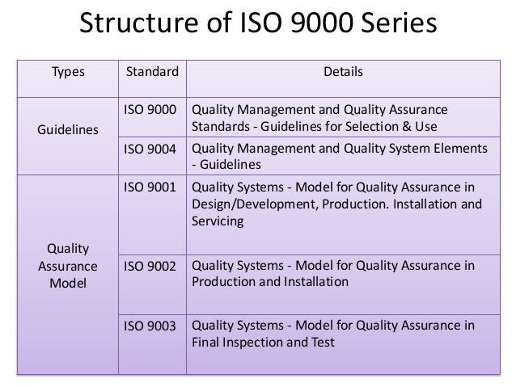

Slide 14
ISO 9000 family standards
The three standards in the family are
ISO 9000 Quality management systems
– Fundamentals and vocabulary
ISO 9001 Quality management systems
– Requirements
ISO 9004 Quality management systems
– Guidelines for performance improvements

Slide 15
ISO 9000 provide an appreciation of the fundamental principles of quality management systems and an explanation of the terminology used in the family of standards.
ISO 9001 states that the standard can be used to assess the organization’s ability to meet customer, regulatory and the organization’s own requirements.
ISO 9004 is to provide guidance for improving the efficiency, effectiveness and overall performance of an organization.

Slide 16

ISO 20000-1:2011
Service Management
ISO 27001-2005
Information Security Management
System
Management
Systems
ISO 9001: 2008
Quality
Management
System
ISO 31000 Risk Management
ISO 22301
Business Continuity Management

Slide 17
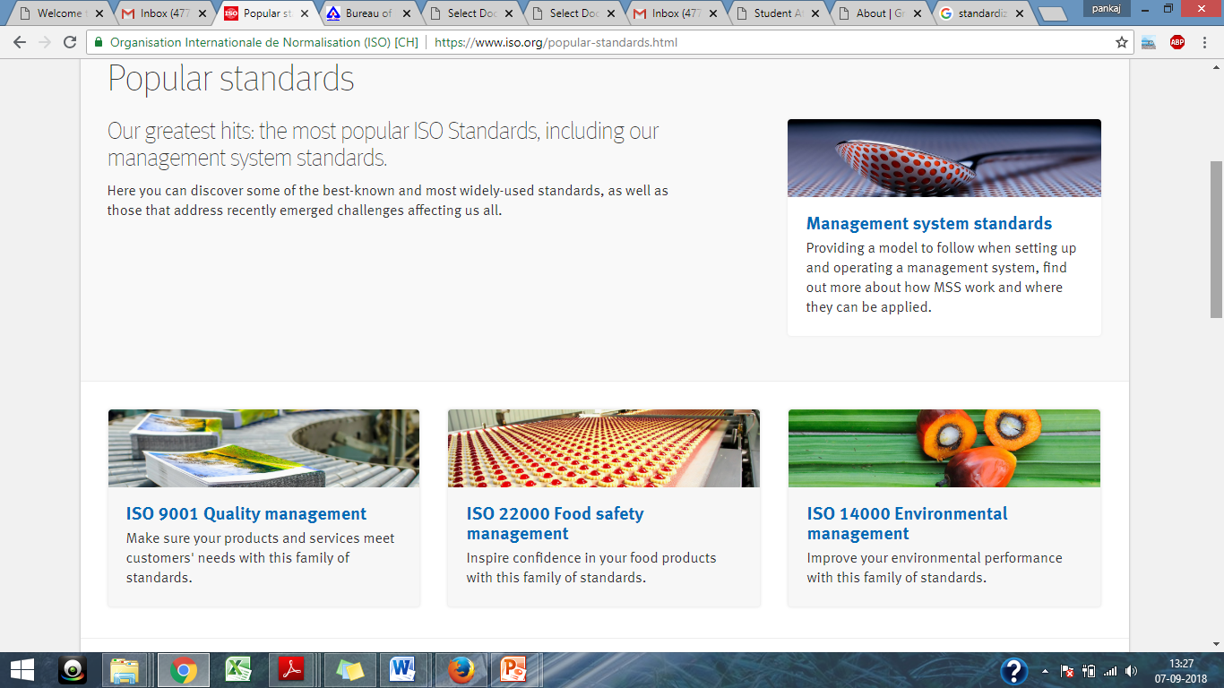
https://www.youtube.com/watch?v=qSVqDNOkOTo&ab_channel=AGFConsultingGroup

Slide 18
Service- It specifies requirements for the service provider to plan, establish, implement, operate, monitor, review, maintain and improve an SMS.
Information Security- Using this family of standards will help your organization manage the security of assets such as financial information, intellectual property, employee details or information entrusted to you by third parties.

Slide 19
Risk- Risks affecting organizations can have consequences in terms of economic performance and professional reputation, as well as environmental, safety. Therefore, managing risk effectively helps organizations to perform well in an environment full of uncertainty.
Business continuity - encompasses planning and preparation to ensure that an organization can continue to operate in case of serious incidents or disasters and is able to recover to an operational state within a reasonably short period.

Slide 20
Benefit/Aspect of QMS
Conformance to the quality specification as documented by organization.
Ensure corrective action is taken whenever defects occur.
Early detection of defects and avoidance of wastage.
Defect rates decrease and reduce costs.
Procedures identify current practices and that continuously improved upon.
Increase in market share, increasing in sales or revenue.
Better management control and reporting.
Consistent quality.

Slide 21
various aspects of quality management
They specify requirements and recommendations for the design and assessment of management systems.
The standards provide guidance and tools for companies and organizations who want to ensure that their products and services consistently meet customer’s requirements, and that quality is consistently improved.
ISO 9000 is a series of three International Standards for Quality Management Systems.

Slide 22
DISADVANTAGES OF ISO 9000
Owners and managers do not have an adequate understanding of the ISO 9000 certification process or of the quality standards themselves
Funding for establishing the quality system is inadequate
Heavy emphasis on documentation
Length of the process

Slide 23
Quality management system requirements are provided by::
ISO 9000
ISO 9001
ISO 22000
ISO 14001

Slide 24
What is ISO 9001 ?
ISO 9001 is an International Standard that gives requirements for an organization’s quality management system (QMS).
It is part of a family of standards published by the International Organization for Standardization (ISO) and often referred to collectively as the“ ISO 9000 series ” or “ ISO 9000 family ”.
The objective of ISO 9001 is to provide a set of requirements.

Slide 25
That, if effectively implemented, will give you confidence that your supplier can consistently provide products and services that: Meet your needs and expectations and Comply with applicable regulations.

Slide 26
Over 3,50,000 companies world are registered to ISO 9001. The benefits they find include:
The Benefits of ISO 9001….
Improved consistency of service and product performance
Higher customer satisfaction levels.
Improved customer perception
Improved productivity and efficiency
Cost reductions
Improved communications, morale and job satisfaction
Competitive advantage and increased marketing and sales opportunities.

Slide 27
Start seeing these benefits in your organization
Benefits start with your implementation project; you do not need to wait until registration is achieved to start seeing the improvements.

Slide 28
Quality Manual, Procedures and Forms
All documented in Microsoft Word and Excel, they are easy to edit and use.
These documents have been used by many different types of industries in many different countries for successful registration to ISO 9001.

Slide 29
Computer Based Training
Employees can take the training at any convenient time.
Appealing visual and audio content keep the employees attention.
Quizzes measure the effectiveness of the training.
Group licensing for as little as $5 per employee.

Slide 30
Documentation and Training Packages are available at a Package price
This package includes:
Project manager’s guide
Project manager online training
Gap Analysis Checklist
Quality Manual, Procedures and Forms
Internal Auditor Training Materials package
Employee Training
Online support for answers to your questions

Slide 31
ISO 9000:2015 describes the fundamental concepts and principles of quality management which are universally applicable to the following.
organizations seeking sustained success through the implementation of a quality management system;
customers seeking confidence in an organization's ability to consistently provide products and services conforming to their requirements;
organizations seeking confidence in their supply chain that their product and service requirements will be met;
organizations and interested parties seeking to improve communication through a common understanding of the vocabulary used in quality management;
organizations performing conformity assessments against the requirements of ISO 9001;
providers of training, assessment or advice in quality management;

Slide 32
Certification Methodology and Cost Involved
Stages of Certification
Submit application to registrar
Stage 1: Assessment of readiness
Stage 2: Assessment for registration audit
Registration/certification awarded for 3 years
Surveillance audits (at least annually)
Recertification audit at the end of 3rd year

Slide 33
Certification Methodology and Cost Involved
Registration:
Usually takes 1 or possibly 2 auditors 1 to 3 days depending on scope, size, locations and personnel
You will be told whether or not you will be recommended for registration at the completion of the Stage 2 audit
Certificate usually arrives a 2 – 6 weeks later
Maintaining your ISO Certification(s) is the first step in continuous improvement

Slide 34
Certification Methodology and Cost Involved
Cost Involved:
Costs can be substantial.
Copies of standards alone can cost $120 or more per copy.
Costs include any courses that quality team members or others need, consultants fees, and the auditor’s time.
According to Nichols, auditor costs are approximately $1,300 per day.
For a small organization, the minimum for everything might be $10,000 to $15,000.

Slide 35
Certification Methodology and Cost Involved
Cost Involved:
The ISO certification body will compute the fee for ISO certification by considering the below mentioned different parameters:
Size of an organization
Number of employees
Processes of Organization
Level of risk associated with the scope of services of the organization
The complexity of the management system
The number of working shifts

Slide 36
Certification Methodology and Cost Involved
Registrar/Auditor Selection Criteria
Accreditation and scope of accreditation
Reputation and customer acceptance
Availability, cost, and location
Knowledge of your business
Culture fit with your organization
Ability to audit all of your future standards
Note: The external auditor is hired by the Registrar and presented with qualifications to you upon agreement of audits. You cannot go out and hire your own external auditor.

Slide 37
Certification Methodology and Cost Involved
Preparation for audit
Determine team, set budget
Internal auditor(s) training if using in-house resources
Hire consulting firm if applicable
Gap Assessment
Implement requirements of standard to meet your business needs against the gap assessment
Go-Live
Hold Management Review Meeting
Conduct Internal Audit
Refine documentation
Employee involvement training
System adjustment
Registration audit – Stage 1
System adjustment
Registration audit – Stage 2

Slide 38
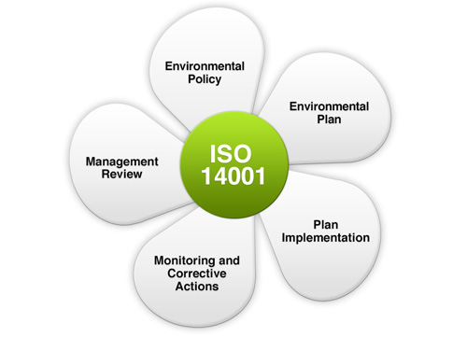

Slide 39
ISO 14000 provided standard for
Food safety
Quality management
Environment management
https://www.youtube.com/watch?v=J7Fak8QI6Ww&ab_channel=ISO
https://www.youtube.com/watch?v=9Yf9zKpiQ7g&ab_channel=JohnBinns

